Slide 1




NETAJI SUBHAS INSTITUTE OF TECHNOLOGY
AI &
EMERGING
TECHNOLOGIES
PRESENTED BY
Aditya Deo (87254021)
Rajnish Kumar (87254030)
MENTORSHIP:
Dr.Reema Dhar Ma’am

Slide 2


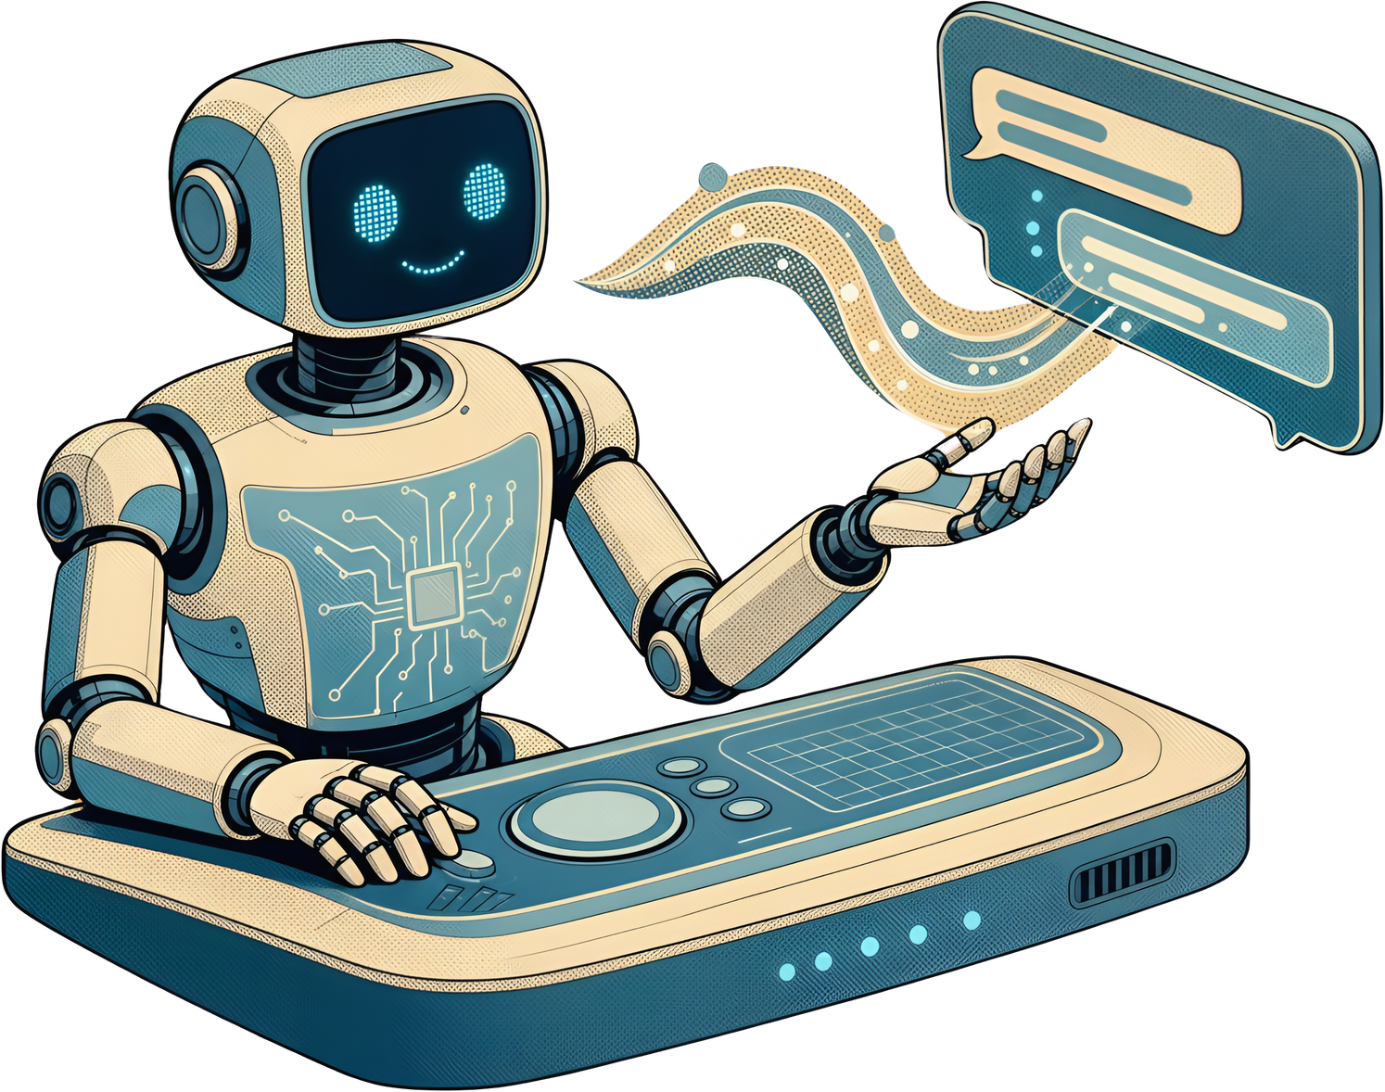


01
AI & EMERGENT
02
Uses Of AI
TABLE
OF CONTENTS
03
Opportunities & Benefits
04
The Future Of AI
05
Emerging Technologies

Slide 3

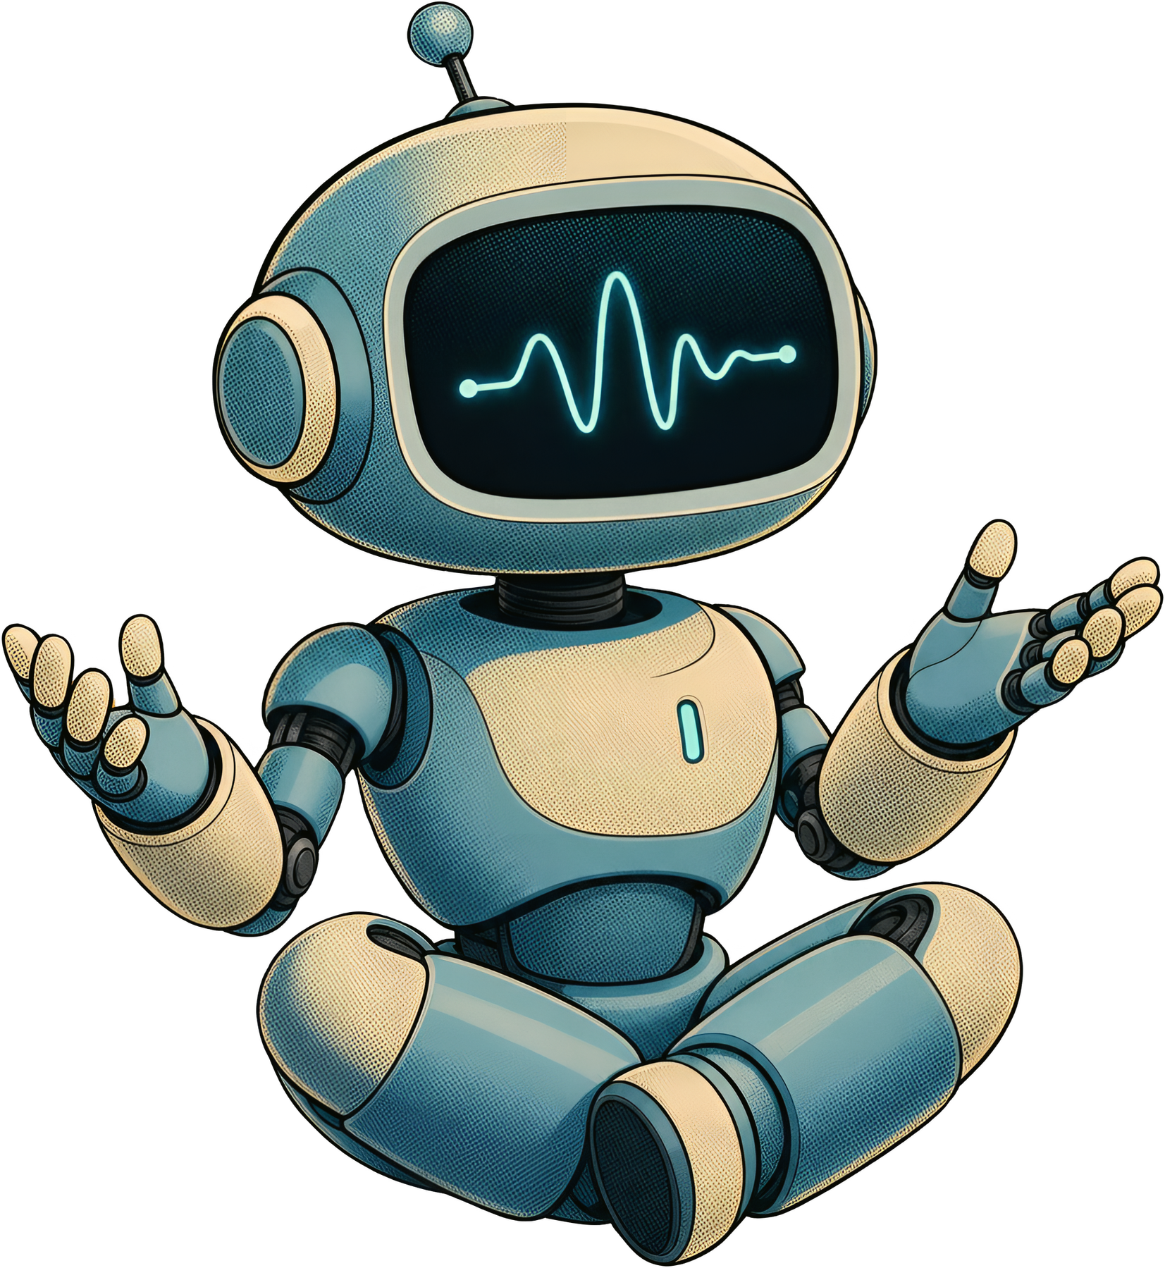


AI & EMERGENT
  AI stands for artificial intelligence, which means computer systems or machines built to do tasks that normally need human brain power .
  AI learning from data, solving problems, understanding speech, recognizing pictures, and making choices. You can read more in-depth
  Emerging or emergent technologies are new or rapidly developing innovations whose practical applications and full societal impacts are still largely unrealized

Slide 4


AI IN EDUCATION
Automated Grading & Feedback
  Intelligent grading systems handle routine assessments, freeing educators to focus on mentorship, creativity, and deeper student engagement.
Generative AI as a Research Partner
  Students use generative AI to brainstorm, refine arguments, and explore ideas — accelerating the research and writing process.

Slide 5


BENEFITS & OPPORTUNITIES
01
02
03
AI automates repetitive operational workflows, massive data sorting, and initial code generation. This frees professionals to focus on higher-level system architecture, creative strategy, and complex decision-making.
Emergent AI models process multi-modal datasets (text, visual data, chemical structures) to rapidly predict protein folds, synthesize novel drug compounds, and detect subtle early diagnostic patterns in patient health records.
As traditional roles adapt, AI drives demand for entirely new roles such as AI governance leads, context/knowledge engineers, and autonomous agent orchestrators, alongside widespread democratization of app development for non-technical creators.

Slide 6

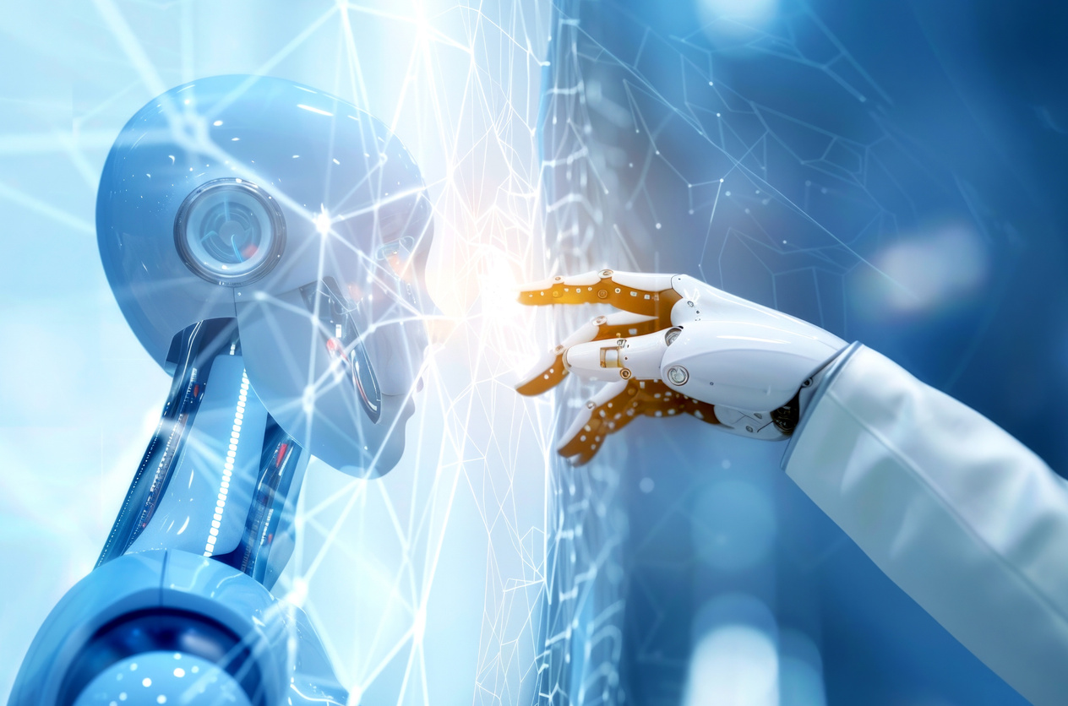
THE FUTURE OF AI
  The future of AI is moving rapidly toward continuous, proactive systems that seamlessly integrate into physical and digital life.
  Artificial Intelligence (AI) is moving away from being a special tool you visit on a website and toward becoming an invisible part of everyday life.
  AI will take over repetitive tasks like data entry, sorting emails, and scheduling.
  Doctors will use AI to design custom medicine and treatment plans tailored exactly to your unique DNA.
  If you are struggling with math, it will slow down and explain the concept in five different ways until you get it.

Slide 7



FINANCIAL IMPACT OF AI
  Estimates from bodies like NASSCOM and NITI Aayog suggest AI will contribute nearly $500B–$967B to the Indian economy over the next decade .
  Global Output: Leading economic models project AI will add between $13 trillion and $15.7 trillion to the global economy by 2030, representing a 14% to 16% boost in global GDP—an economic shift comparable to the industrial revolution

Slide 8
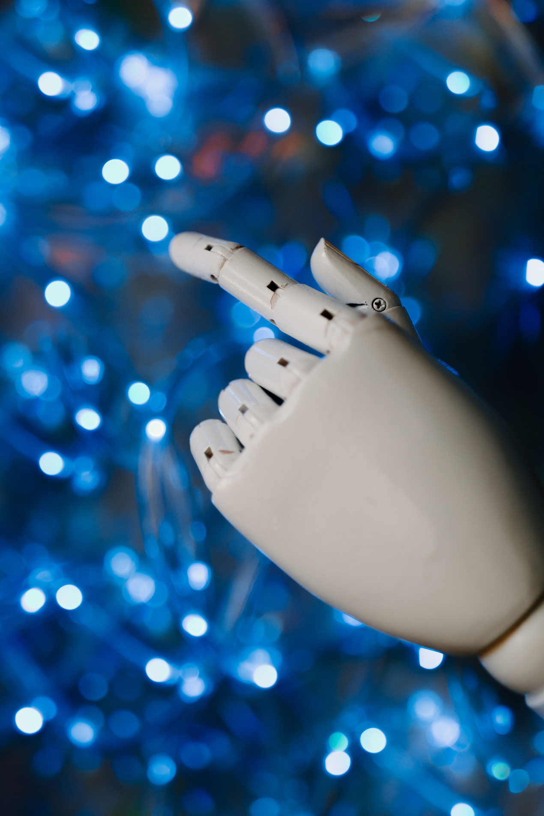
EMERGING TECHNOLOGY AROUND AI
  India is rapidly building a future-ready technology ecosystem through national missions in artificial intelligence, semiconductors, quantum computing, and digital public infrastructure.
  Platforms like UPI, Aadhaar, and the India Stack serve as global models for delivering scalable, low-cost digital services.
  Semicon India Programme and India Semiconductor Mission (ISM) 2.0, India is building local chip design, manufacturing, and packaging facilities to secure tech sovereignty.

Slide 9
THANK YOU FOR YOUR ATTENTION

